Slide 1
Air Academy Contest
Spartan Winners!!!

Slide 2
Six out of ten prizes were awarded to our very own Spartans….

Slide 3
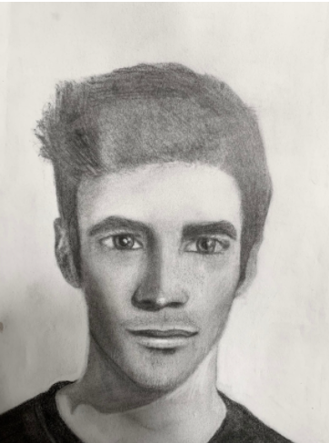
9th Grade 1st Place!!!
Sabrina Szostak
Photo courtesy of Art Teacher Kevin Comiskey

Slide 4
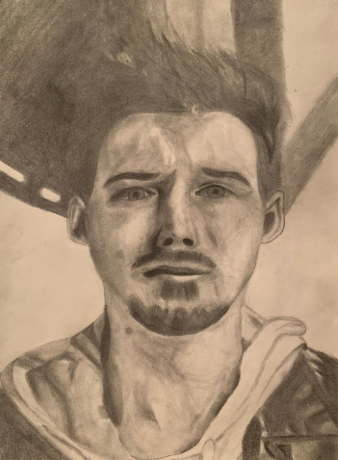
9th Grade 2nd Place!!!
Brayden Unseth
Photo courtesy of Art Teacher Kevin Comiskey

Slide 5
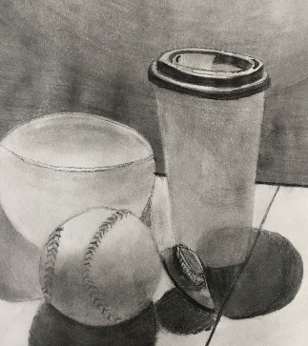
9th Grade 3rd Place!!!
Chole Wilkins
Photo courtesy of Art Teacher Kevin Comiskey

Slide 6
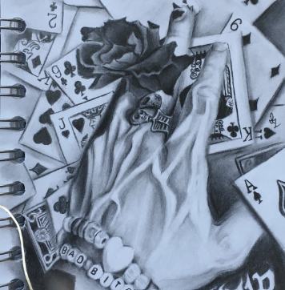
10th Grade 1st Place!!!
Isabelle Crnich
Photo courtesy of Art Teacher Kevin Comiskey

Slide 7
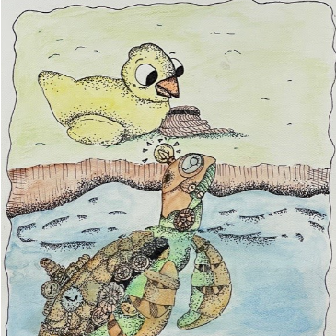
10th Grade 3rd Place!!!
Izabella Seaks
Photo courtesy of Art Teacher Kevin Comiskey

Slide 8
11th Grade 2nd Place
Riley Locke
Photo courtesy of Art Teacher Kevin Comiskey

Slide 9
Great Job Guys!
Make sure to congratulate our Spartans on their win if you see them!

